Slide 1
Final Year Project
NATURAL LANGUAGE PROCESSING
Members:-
Tejendra Pratap (001811001007)
Zaid Ahmad (001811001042)
Mentor:-
Tohida Rehman

Slide 2
Basics Of Natural Language Processing
Tokenization
Stop Words
Stemming
Lemmatization
Bag of Words
TF-IDF

Slide 3
Research Paper : PRETRAINED LANGUAGE MODELS FOR SEQUENTIAL SENTENCE
Objective:
Classification of sequence of sentences into corresponding categories , taking into consideration the context of the document.
The meaning of a sentence in a document is often informed by context from neighboring sentences.
Dataset:
Scientific abstract sentence classification
a) PUBMED-RCT b) CSABSTRUCT c) NICTA

Slide 4
Model
An approach for SSC (Sequential Sentence Classification) based on BERT to encode sentences in context.
A large sequence is formed from many sentences, separated by [ SEP ] delimiter, [ CLS ] is added in the starting and it is fed to BERT.
Encodings of [ SEP ] tokens is used to classify each sentence instead of using [ CLS ] tokens, as used in BERT.
The pretrained model is finetuned on task-specific training data, where the model learns appropriate weights of the [ SEP ] tokens to allow it to capture contextual info.
BERT pretrained weights support 512 wordpieces.
The meaning of a sentence is mostly dependent on local context. So a threshold is set on the number of sentences in each sequence.
We bisect the document until we have sequences with sentences less than threshold.
Limitation
Sentences on edge of the division may lose context.

Slide 5
Research Paper : QMSum: A New Benchmark for Query-based Multi-domain Meeting Summarization
Meetings are key components of human collaboration. As increasing numbers of meetings are recorded and transcribed, meeting summaries have become essential to remind those who may or may not have attended the meetings about the key decisions made and the tasks to be completed.
However, it is hard to create a single short summary that covers all the content of a long meeting involving multiple people and topics. In order to satisfy the needs of different types of users, a new query-based multi-domain meeting summarization task has been defined, where models have to select and summarize relevant spans of meetings in response to a query.
QMSum, a new benchmark for this task has been introduced.

Slide 6
Method
It is a 2-step process:
Locator:
The first step requires a model to locate the relevant text spans in the meeting according to the queries.
The reason why we need a Locator here is, most existing abstractive models cannot process long texts such as meeting transcripts. So we need to extract shorter, query-related paragraphs as input to the following Summarizer.
Summarizer:
The goal in the second stage is to summarize the selected text spans based on the query.
The following 3 models can be used for this purpose:
Pointer-Generator Network
BART
HMNet

Slide 7
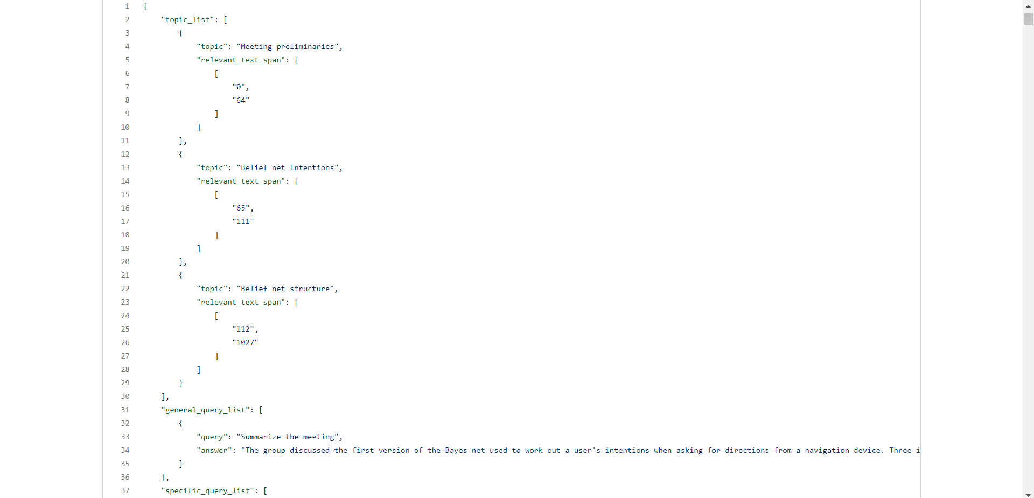
Dataset Format

Slide 8
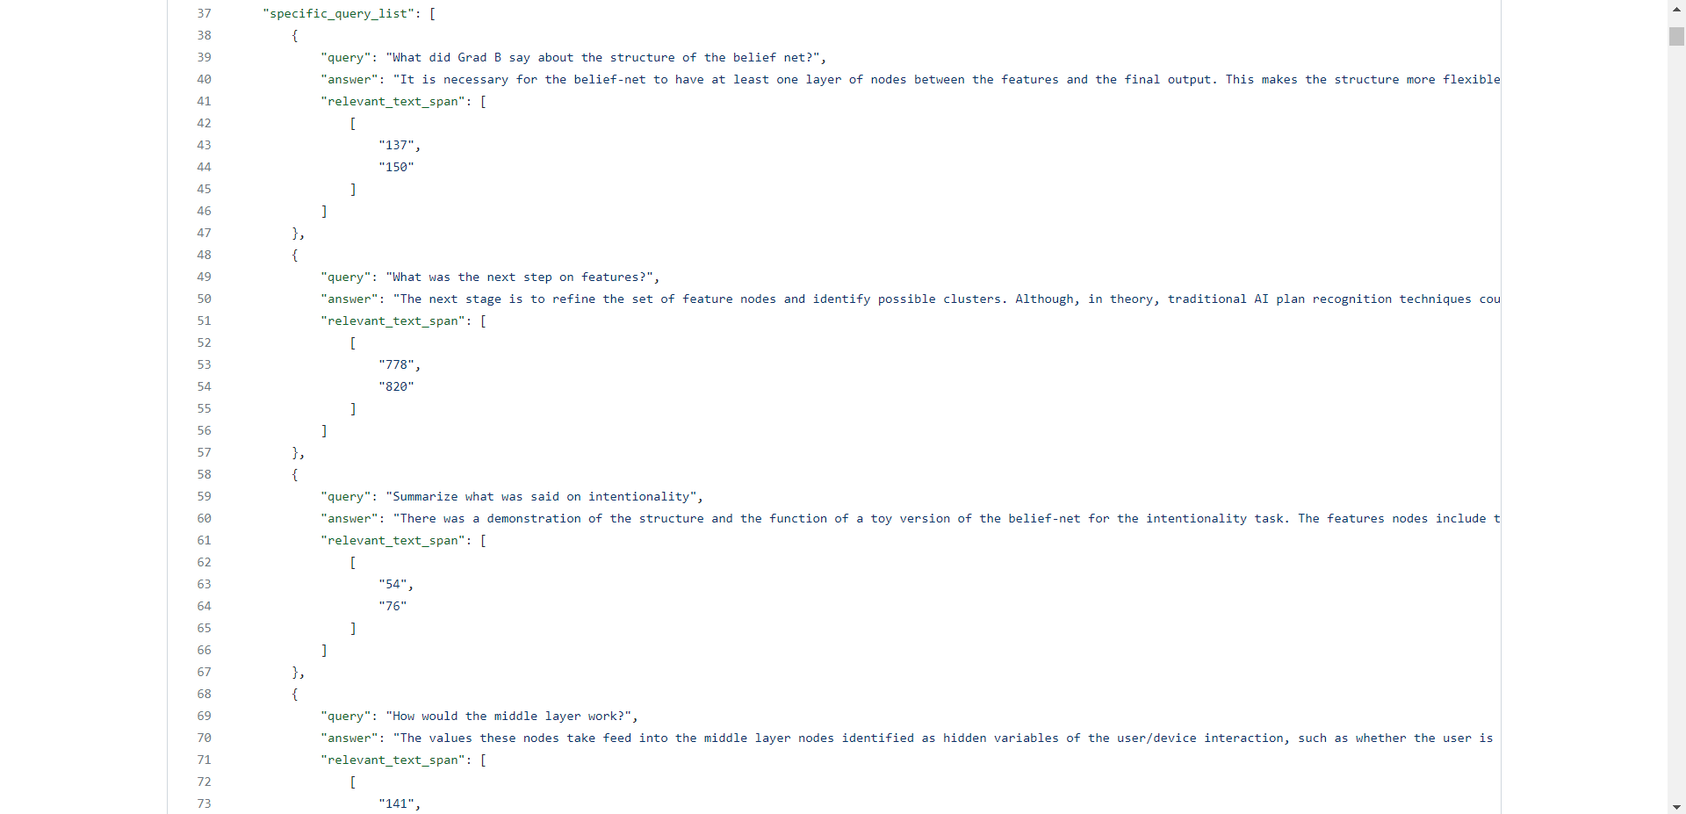

Slide 9
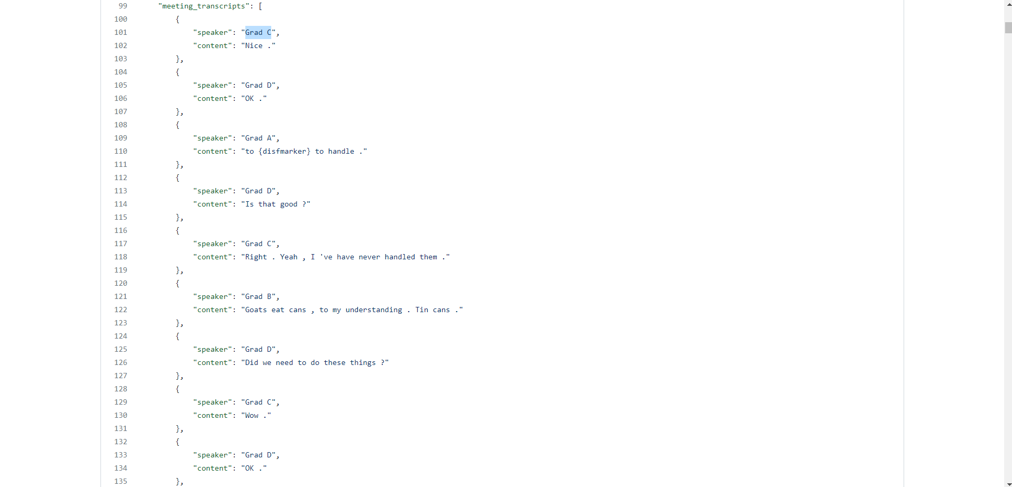

Slide 10
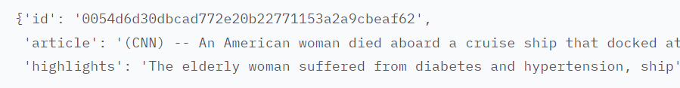
Research Paper : Test Summarization with Latent Queries
Focuses on Query Focused Summarization on query free resources
Dataset Preparation
Input Dataset Format :

Slide 11
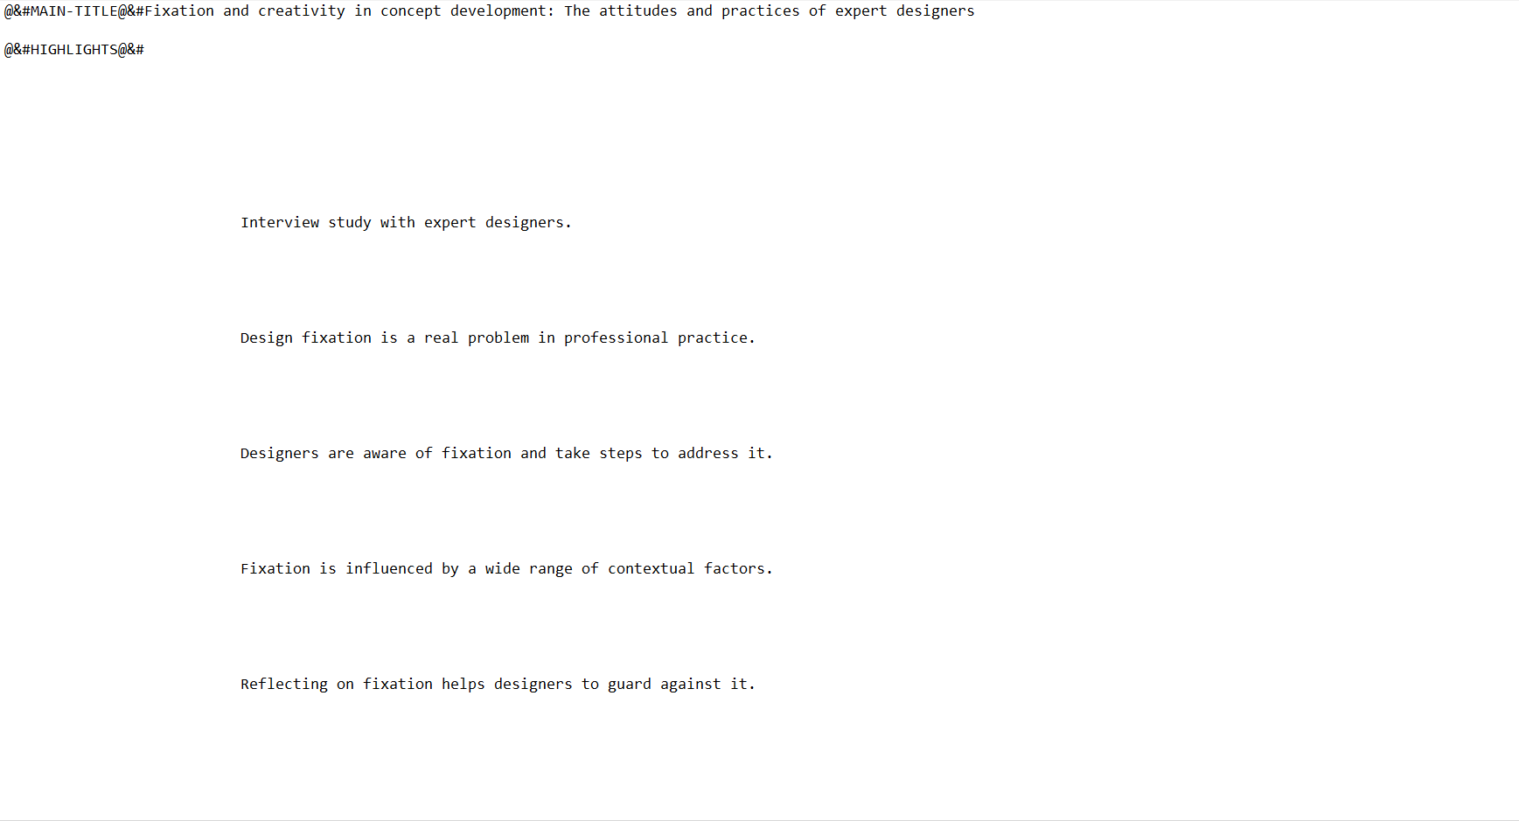
Raw Dataset

Slide 12
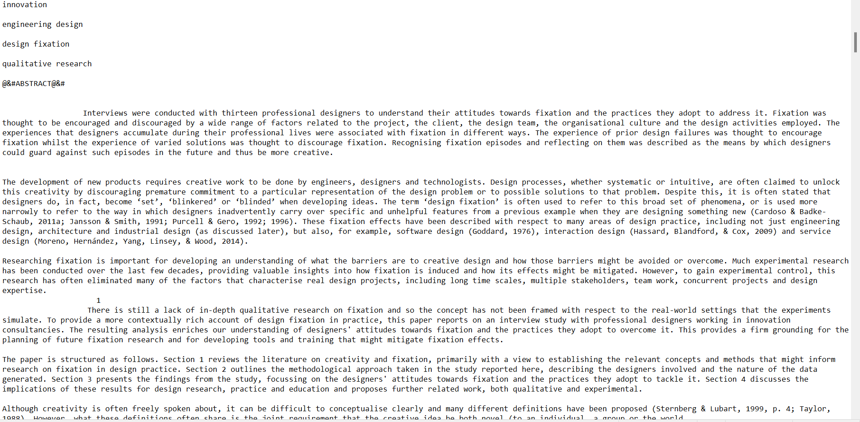
Raw Dataset

Slide 13
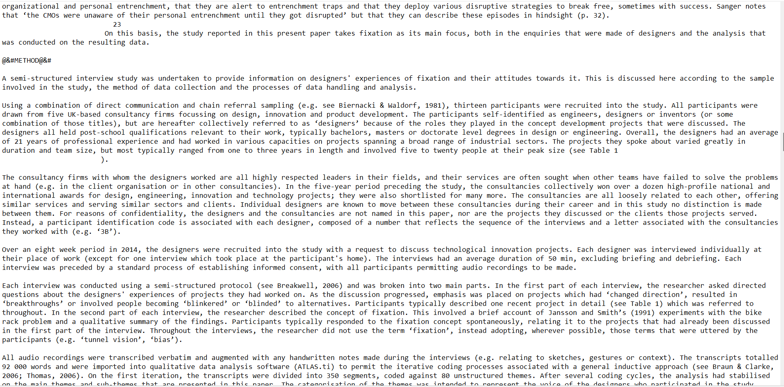
Raw Dataset

Slide 14
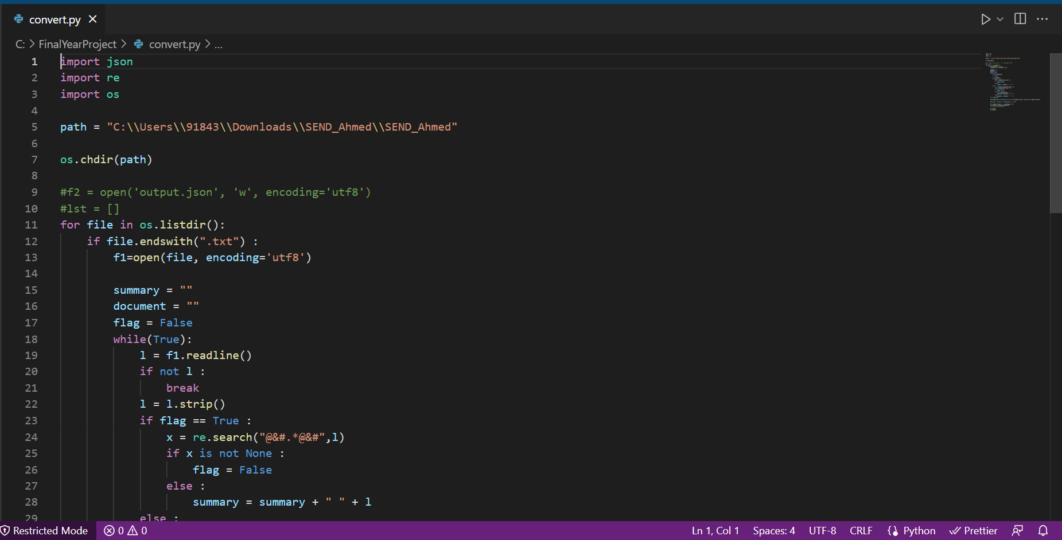
Code

Slide 15
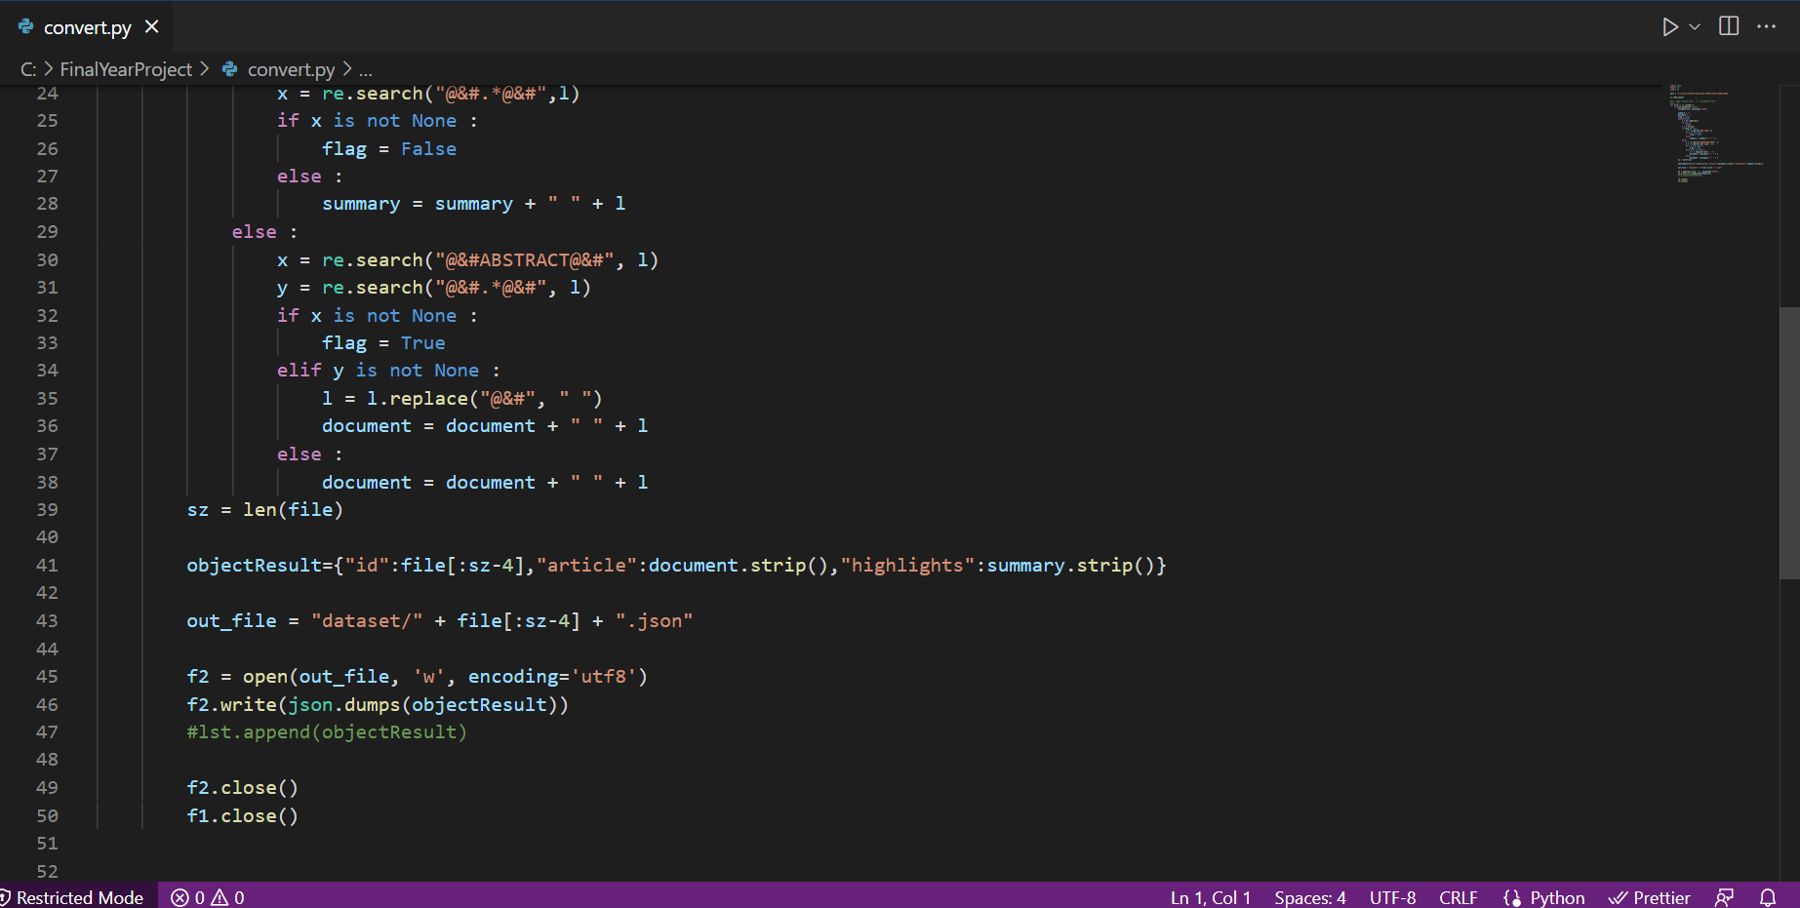
Code

Slide 16
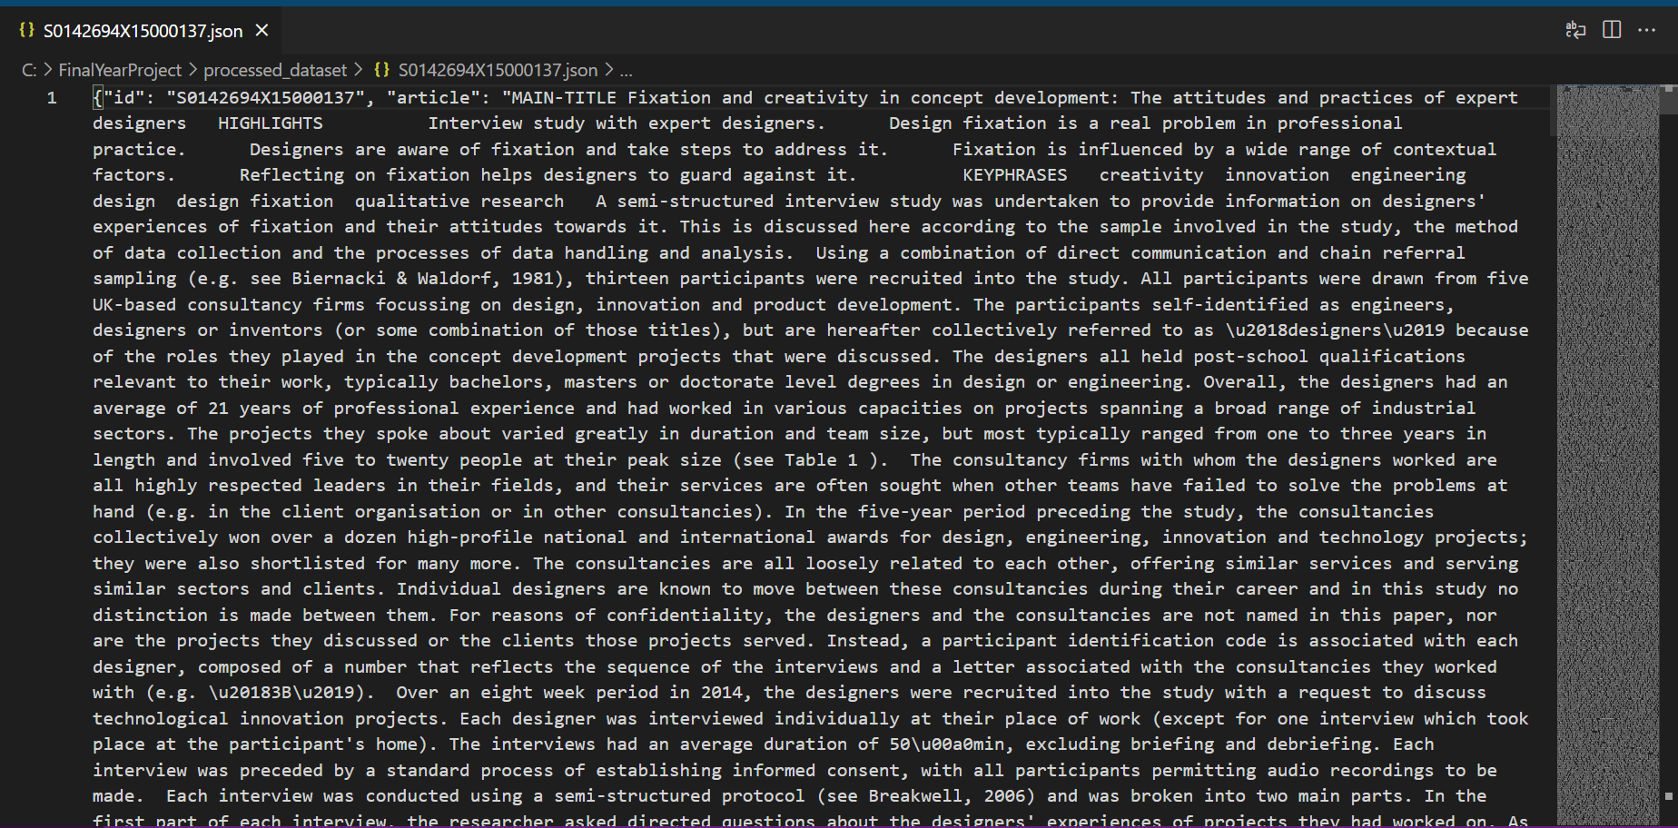
Processed Dataset

Slide 17
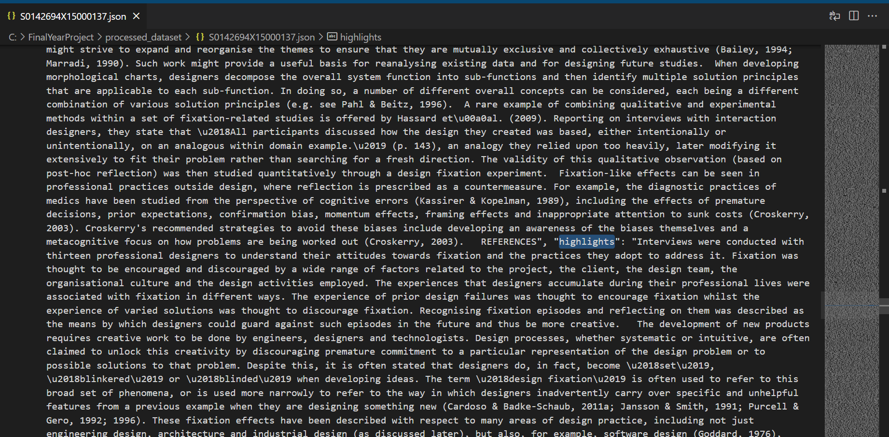
Processed Dataset

Slide 18
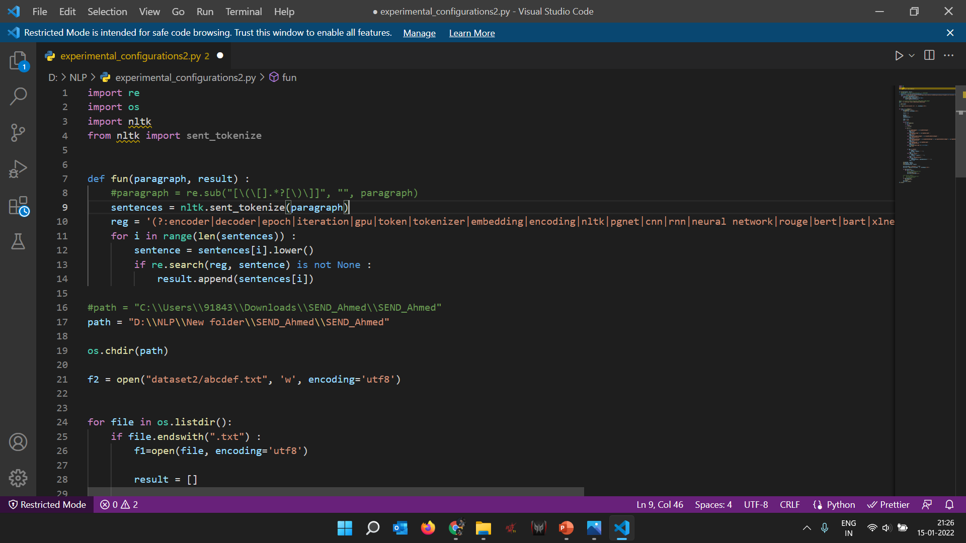
Extracting the experimental configuration from the research papers

Slide 19
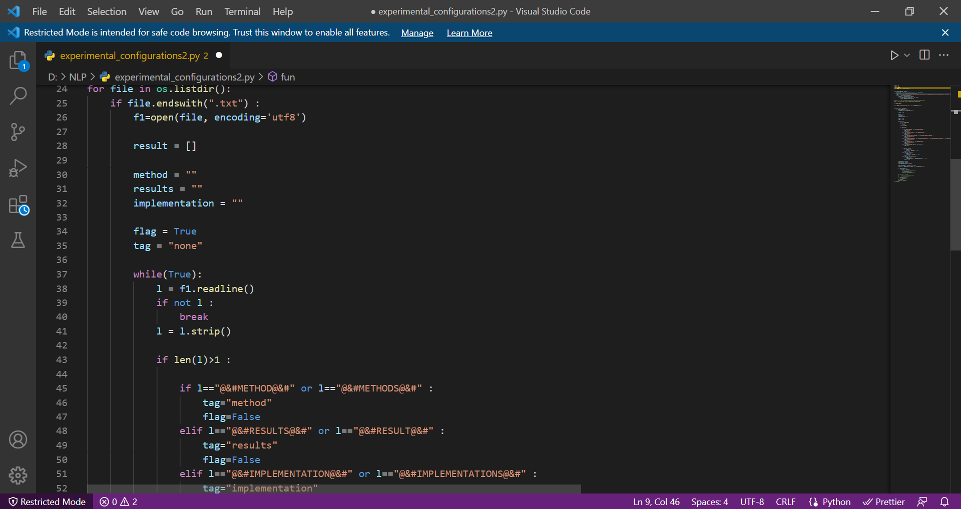

Slide 20
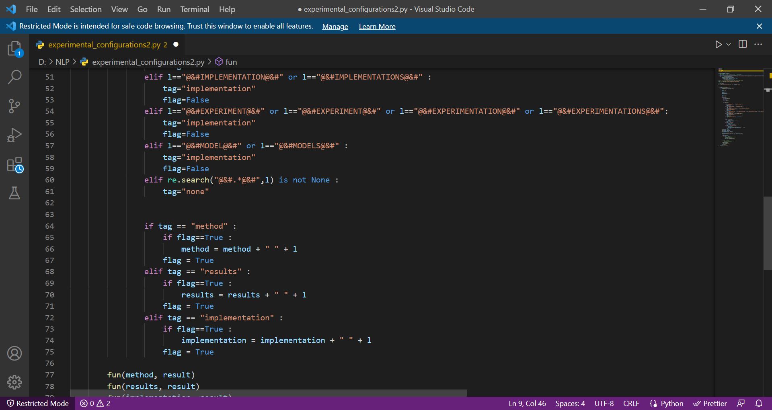

Slide 21
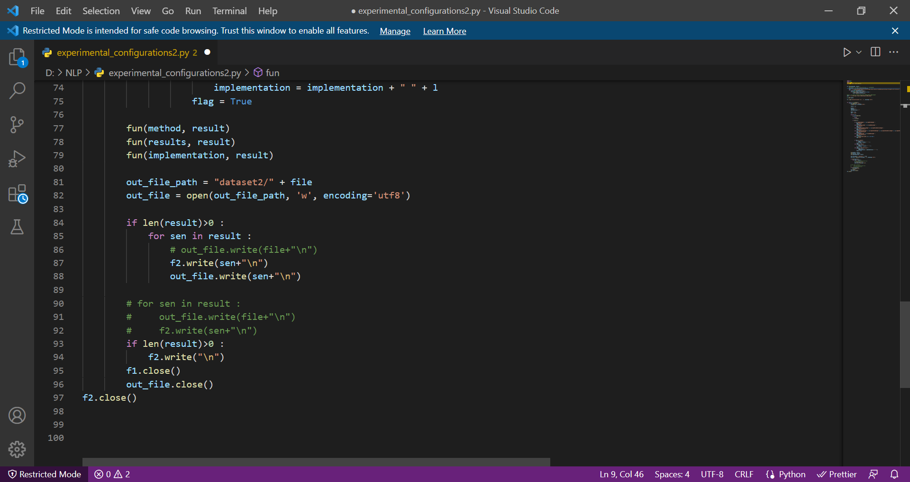

Slide 22
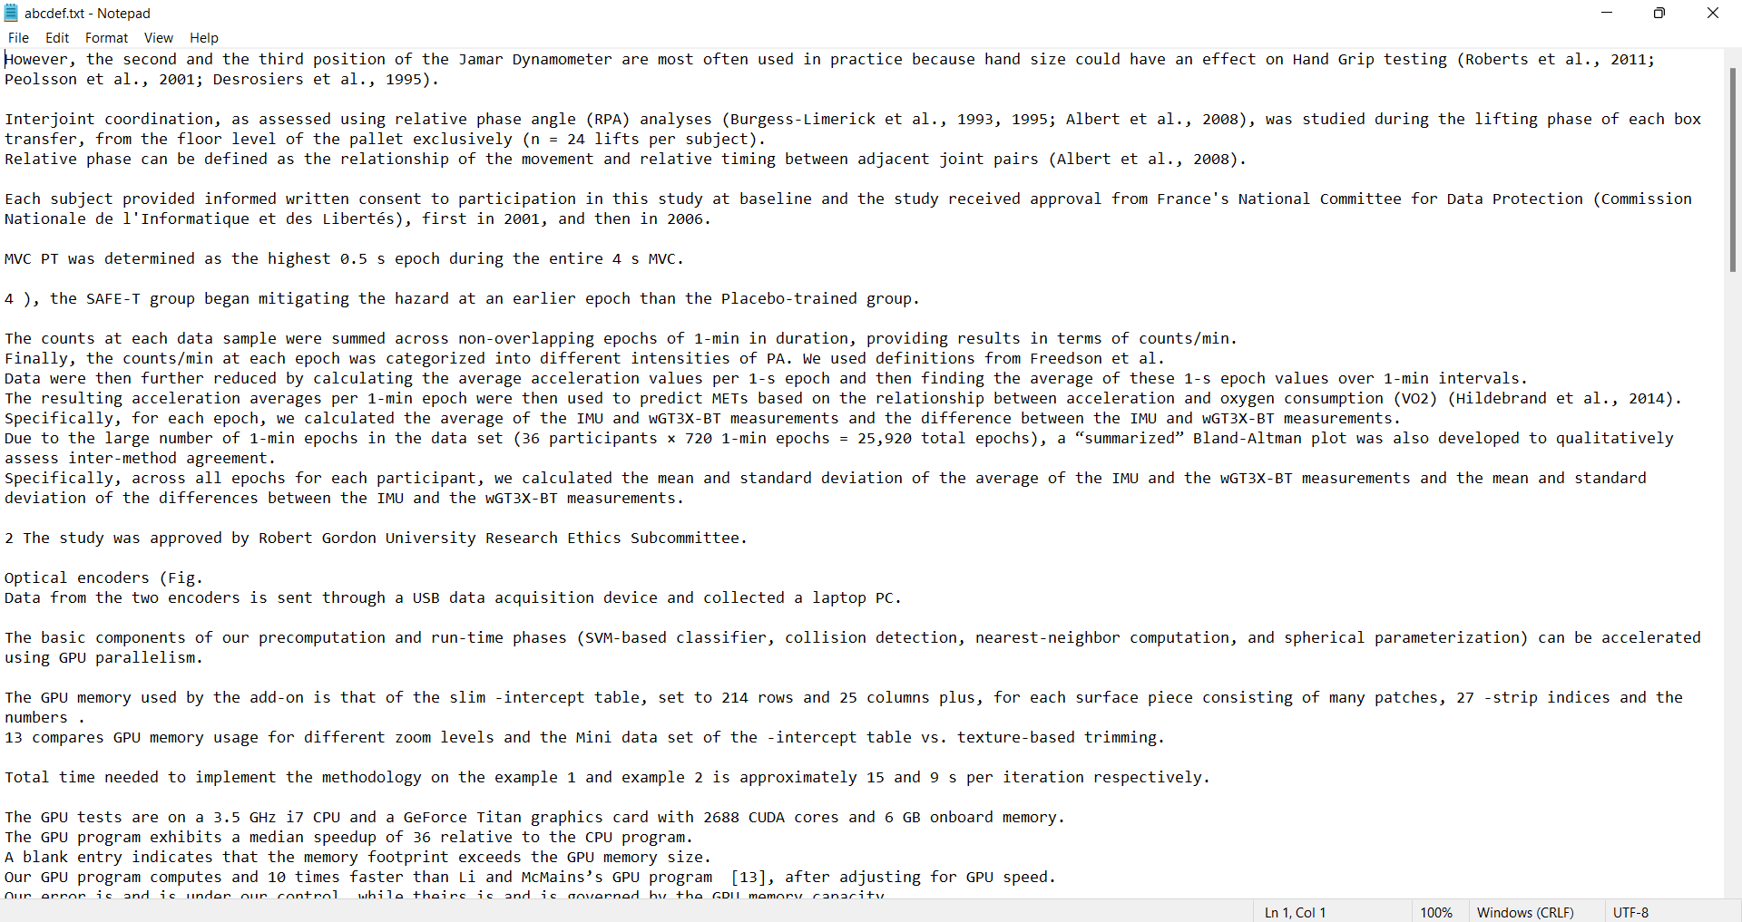

Slide 23
What Next ?
Research on making use of some question answering model or slot tagging for extracting experimental configuration from research papers.
Implement the research papers.

Slide 24
THANK YOU

